Slide 1
Module 8
Center and Spread

Slide 2
Announcements

Slide 3
Center and Spread

Slide 4
Questions
How can we quantify natural concepts like “center” and “variability”?
Why do many of the empirical distributions that we generate come out bell shaped?
How is sample size related to the accuracy of an estimate?

Slide 5
Average

Slide 6
The Average (or Mean)
Data: 2, 3, 3, 9 Average = (2+3+3+9)/4 = 4.25
Need not be a value in the collection
Need not be an integer even if the data are integers
Somewhere between min and max, but not necessarily halfway in between
Same units as the data
Smoothing operator: collect all the contributions in one big pot, then split evenly
(Demo)

Slide 7
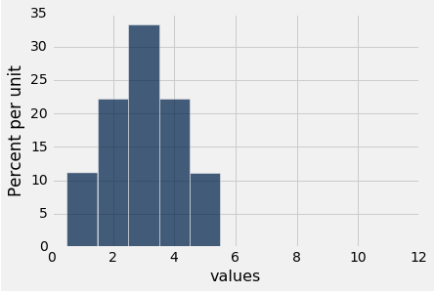
Discussion Question
Create a data set that has this histogram. (You can do it with a short list of whole numbers.)
What are its median and mean?

Slide 8
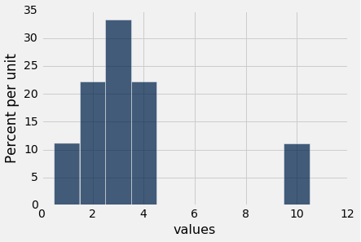
Discussion Question
Are the medians of these two distributions the same or different? Are the means the same or different? If you say “different,” then say which one is bigger.

Slide 9
Comparing Mean and Median
Mean: Balance point of the histogram
Median: Half-way point of data; half the area of histogram is on either side of median
If the distribution is symmetric about a value, then that value is both the average and the median.
If the histogram is skewed, then the mean is pulled away from the median in the direction of the tail.

Slide 10
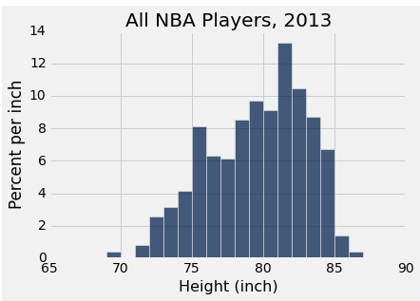
Discussion Question
Which is bigger?
(a) mean
(b) median

Slide 11
Standard Deviation

Slide 12
Defining Variability
Plan A: “biggest value - smallest value”
Doesn’t tell us much about the shape of the distribution
Plan B:
Measure variability around the mean
Need to figure out a way to quantify this
(Demo)

Slide 13
How Far from the Average?
Standard deviation (SD) measures roughly how far the data are from their average
SD = root mean square of deviations from average
5 4 3 2 1
SD has the same units as the data

Slide 14
Why Use the SD?
There are two main reasons.
The first reason:
No matter what the shape of the distribution,
the bulk of the data are in the range “average ± a few SDs”
The second reason:
Coming up in the next lecture.

Slide 15
Chebyshev's Inequality

Slide 16
The Mathematician’s Name
Chebyshev
Chebychev
Chebishov
Čebyšev
Tchebichev
Tchebicheff
Tschebyscheff
Tschebyschew
Чебышёв

Slide 17
How Big are Most of the Values?
No matter what the shape of the distribution,
the bulk of the data are in the range “average ± a few SDs”
Chebyshev’s Inequality
No matter what the shape of the distribution,
the proportion of values in the range “average ± z SDs” is
at least 1 - 1/z²

Slide 18
Chebyshev’s Bounds
Range | Proportion
average ± 2 SDs | at least 1 - 1/4 (75%)
average ± 3 SDs | at least 1 - 1/9 (88.888…%)
average ± 4 SDs | at least 1 - 1/16 (93.75%)
average ± 5 SDs | at least 1 - 1/25 (96%)
No matter what the distribution looks like

Slide 19
Standard Units

Slide 20
Standard Units
How many SDs above average?
z = (value - average)/SD
Negative z: value below average
Positive z: value above average
z = 0: value equal to average
When values are in standard units: average = 0, SD = 1
Chebyshev: At least 96% of the values of z are between -5 and 5
(Demo)

Slide 21
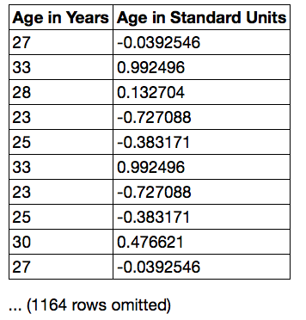
Discussion Question
Find whole numbers that are close to:
the average age
the SD of the ages
(Demo)

Slide 22
The SD and the Histogram
Usually, it's not easy to estimate the SD by looking at a histogram.
But if the histogram has a bell shape, then you can.

Slide 23
The SD and Bell-Shaped Curves
If a histogram is bell-shaped, then
the average is at the center
the SD is the distance between the average and the points of inflection on either side
(Demo)

Slide 24
Module 8
The Normal Curve

Slide 25
Standard Units (review)

Slide 26
Standard Units
How many SDs above average?
z = (value - average)/SD
Negative z: value below average
Positive z: value above average
z = 0: value equal to average
When values are in standard units: average = 0, SD = 1
Chebyshev: At least 96% of the values of z are between -5 and 5
(Demo)

Slide 27
Discussion Question
Find whole numbers that are close to:
the average age
the SD of the ages
(Demo)

Slide 28
The SD and the Histogram
Usually, it's not easy to estimate the SD by looking at a histogram.
But if the histogram has a bell shape, then you can.

Slide 29
The SD and Bell-Shaped Curves
If a histogram is bell-shaped, then
the average is at the center
the SD is the distance between the average and the points of inflection on either side
(Demo)

Slide 30
The Normal Distribution

Slide 31
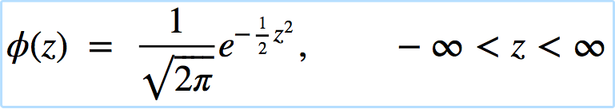
The Standard Normal Curve
A beautiful formula that we won’t use at all:

Slide 32
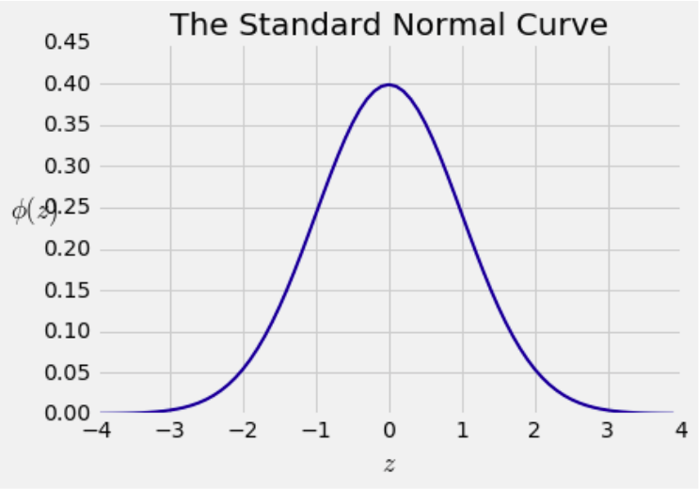
Bell Curve

Slide 33
Normal Proportions

Slide 34
How Big are Most of the Values?
No matter what the shape of the distribution,
the bulk of the data are in the range “average ± a few SDs”
If a histogram is bell-shaped, then
Almost all of the data are in the range
“average ± 3 SDs”

Slide 35
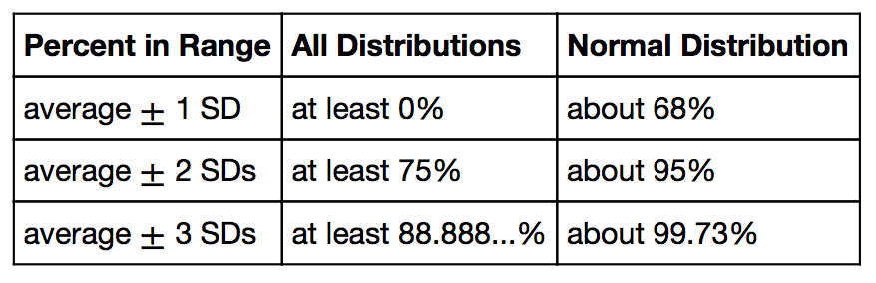
Bounds and Normal Approximations

Slide 36
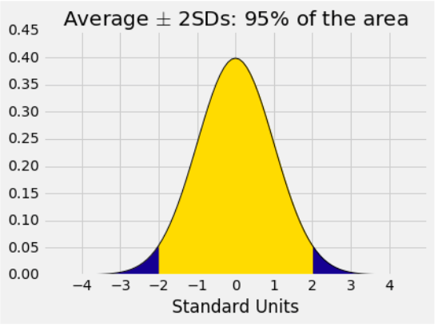
A “Central” Area

Slide 37
Normal Curve in Practice

Slide 38
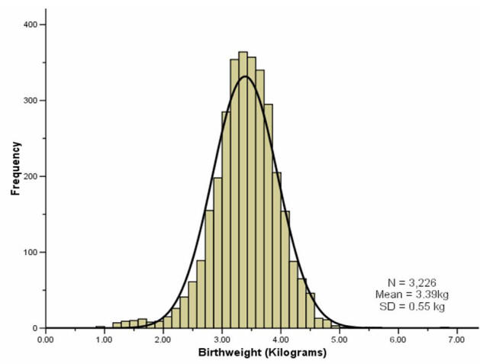
Birth weights of babies

Slide 39
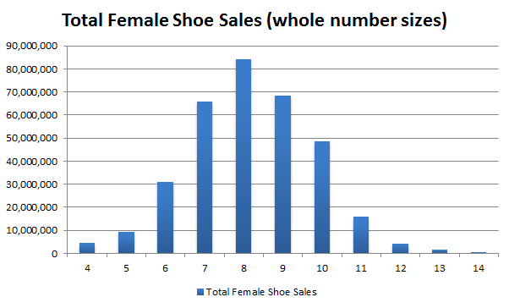
Sales of shoes for women

Slide 40
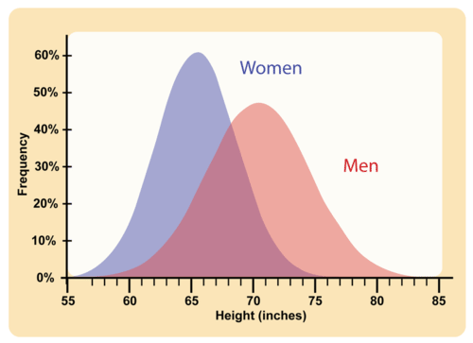
Heights of men and women

Slide 41
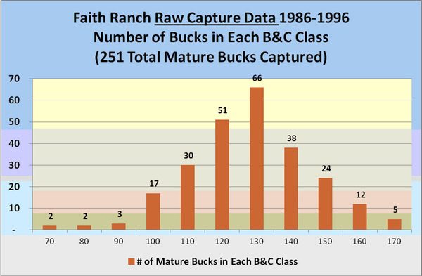
Lengths of Deer Antlers

Slide 42
The Mystery
Why is the normal distribution so common?

Slide 43
Central Limit Theorem

Slide 44
Second Reason for Using the SD
If the sample is
large, and
drawn at random with replacement,
Then, regardless of the distribution of the population,
the probability distribution of the sample sum
(or of the sample average) is roughly normal
(Demo)

Slide 45
Module 8
Designing Experiments

Slide 46
Questions we are studying
How can we quantify natural concepts like “center” and “variability”?
Why do many of the empirical distributions that we generate come out bell shaped?
How is sample size related to the accuracy of an estimate?

Slide 47
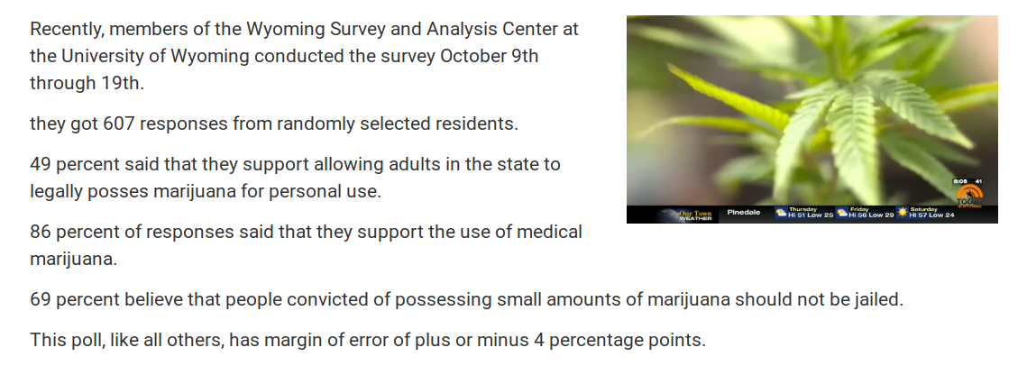
How do they know?

Slide 48
Variability of the Sample Average
The distribution of all possible sample averages of a given size is called the distribution of the sample average.
We approximate it by an empirical distribution.
By the CLT, it’s roughly normal:
Center = the population average
SD = (population SD) / √sample size

Slide 49
Discussion Question
A city has 500,000 households. The annual incomes of these households have an average of $65,000 and an SD of $45,000. The distribution of the incomes [pick one and explain]:
is roughly normal because the number of households is large.
is not close to normal.
may be close to normal, or not; we can’t tell from the information given.

Slide 50
Discussion Question
A city has 500,000 households. The annual incomes of these households have an average of $65,000 and an SD of $45,000. A random sample of 900 households is taken.
Fill in the blanks and explain:
There is about a 68% chance that the average annual income of the sampled households is in the range
$__________ plus or minus $__________

Slide 51
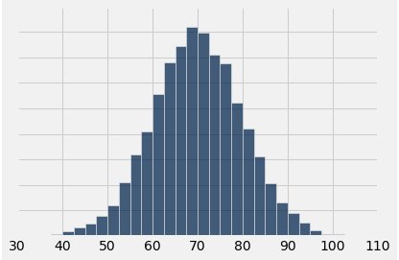
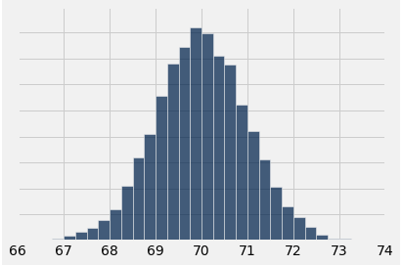
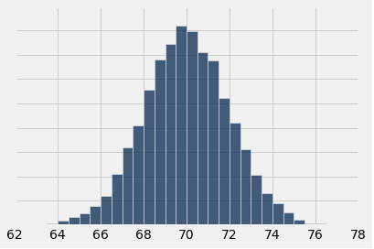
Discussion Question
A population has average 70 and SD 10. One of the histograms below is the empirical distribution of the averages of 10,000 random samples of size 100 drawn from the population. Which one?
(A)
(B)
(C)

Slide 52
Confidence Intervals

Slide 53
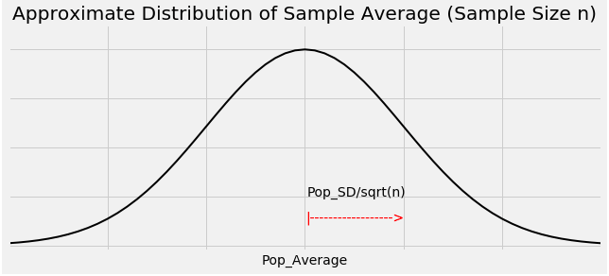
Graph of the Distribution

Slide 54
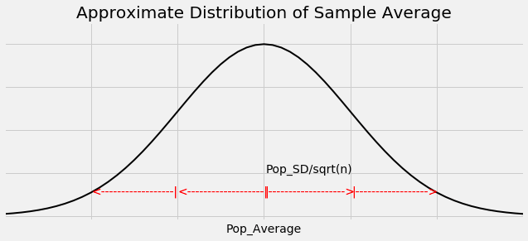
The Key to 95% Confidence
For about 95% of all samples, the sample average and population average are within 2 SDs of each other.
SD = SD of sample average
= (population SD) / √sample size

Slide 55
Constructing the Interval
For 95% of all samples,
If you stand at the population average and look two SDs on both sides, you will find the sample average.
Distance is symmetric.
So if you stand at the sample average and look two SDs on both sides, you will capture the population average.

Slide 56
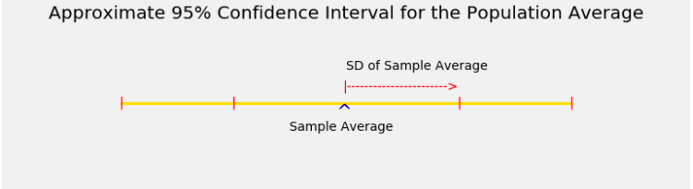
The Interval

Slide 57
Width of the Interval
Total width of a 95% confidence interval for the population average
= 4 * SD of the sample average
= 4 * (population SD) / √sample size

Slide 58
Sample Proportions

Slide 59
Proportions are Averages
Data: 0 1 0 0 1 0 1 1 0 0 (10 entries)
Sum = 4 = number of 1’s
Average = 4/10 = 0.4 = proportion of 1’s
If the population consists of 1’s and 0’s (yes/no answers to a question), then:
the population average is the proportion of 1’s in the population
the sample average is the proportion of 1’s in the sample

Slide 60
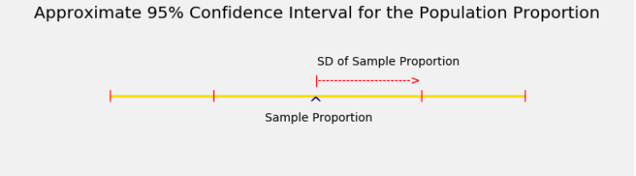
Confidence Interval

Slide 61
Controlling the Width
Total width of an approximate 95% confidence interval for a population proportion
= 4 * (SD of 0/1 population) / √sample size
The narrower the interval, the more accurate your estimate.
Suppose you want the total width of the interval to be no more than 3%. How should you choose the sample size?

Slide 62
The Sample Size for a Given Width
0.03 = 4 * (SD of 0/1 population) / √sample size
Left hand side is 3%, the maximum total width that you will accept
Right hand side is the formula for the total width
√sample size = 4 * (SD of 0/1 population) / 0.03
(Demo)

Slide 63
“Worst Case” Population SD
√sample size = 4 * (SD of 0/1 population) / 0.03
SD of 0/1 population is at most 0.5
√sample size ≥ 4 * 0.5 / 0.03
sample size ≥ (4 * 0.5 / 0.03) ** 2 = 4444.44
The sample size should be 4445 or more

Slide 64
Discussion Question
A researcher is estimating a population proportion based on a random sample of size 10,000.
Fill in the blank with a decimal:
With chance at least 95%, the estimate will be correct to within ________________.

Slide 65
Discussion Question
I am going to use a 68% confidence interval to estimate a population proportion.
I want the total width of my interval to be no more than 2.5%.
How large must my random sample be?
2 * (0.5) / sqrt(sample size) = 0.025

